Slide 1
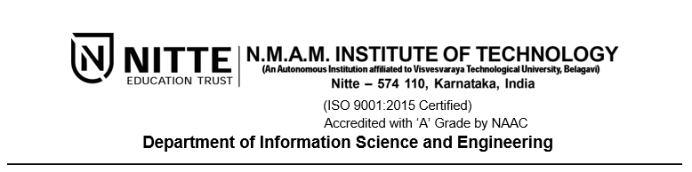
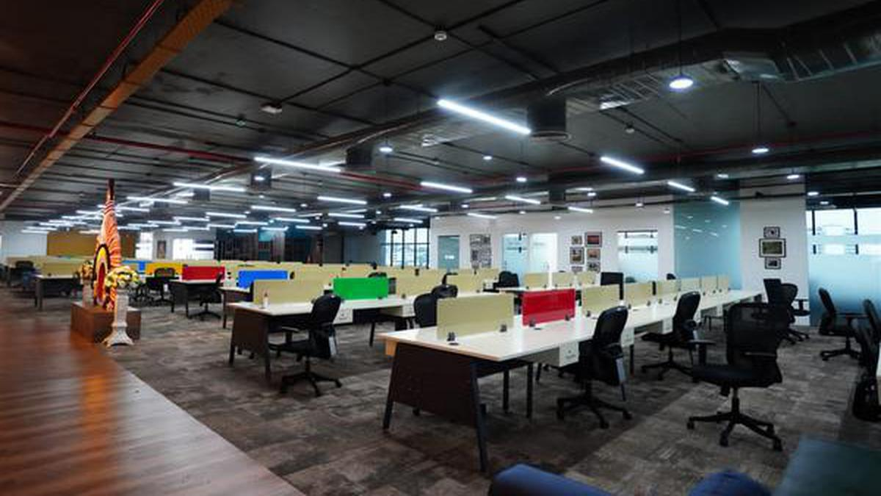
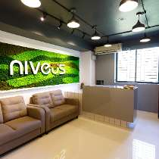
Internship at solutions
Varun R Rao
4NM20IS174
Presented to
Dr. Bola Sunil Kamath
Mr. Vasudeva Pai

Slide 2
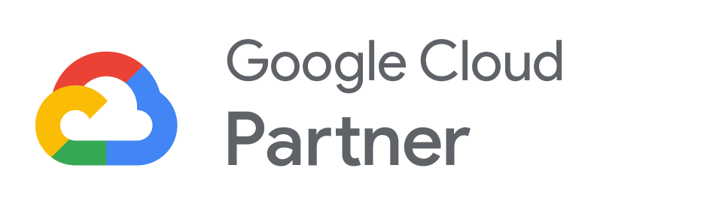
Introduction of
-boot-strapped cloud engineering services organization
-founded by Suyog Shetty, Rashmi George, Roshan Bava, and Mohsin Khan in Karnataka, India
-Google Cloud Platform Partner
-cloud consulting, app modernization, infrastructure modernization, data modernization, platform migration, cloud-native application development, cloud security, and managed services

Slide 3
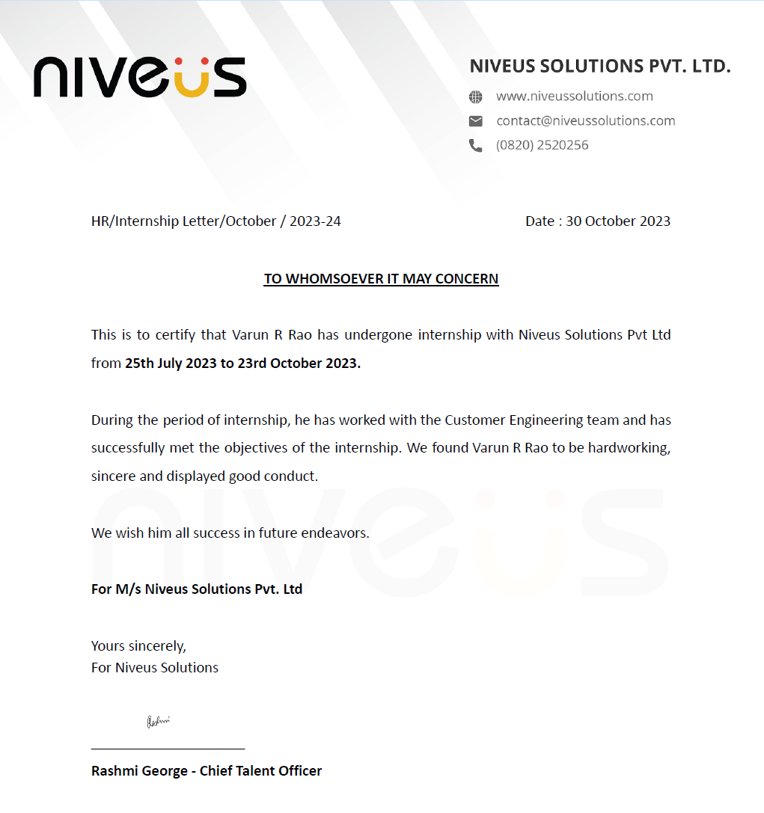
Completion Certificate Internship Duration:- 3 months Hybrid Start Date: 25th July 2023 End Date: 23rd October 2023

Slide 4
Objectives Achieved
To Implement DLP in Google Cloud
To develop a DocAI parser tool in Google Cloud Workbench
To Integrate Big Query and Kafka in tinybird tool

Slide 5
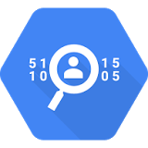
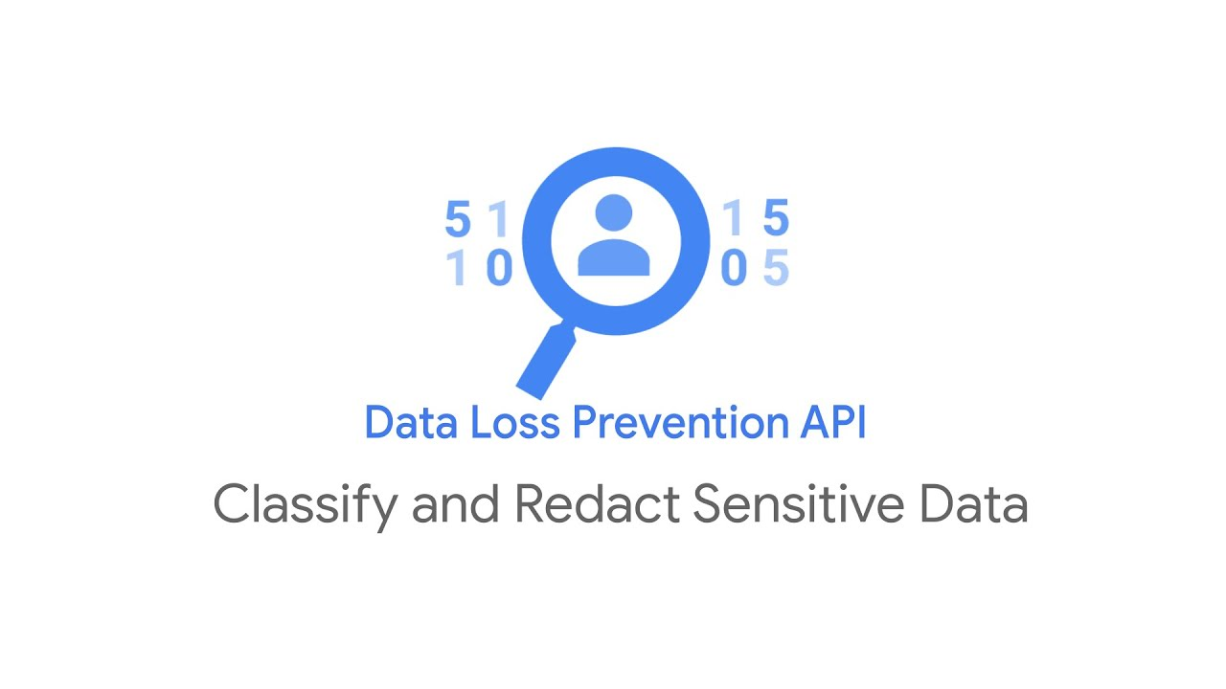
Data Loss Protection in Google Cloud
Plays an essential role in safeguarding personal data
Helps in complying with data privacy regulations
It detects and protects sensitive information
-such as Aadhar numbers, DOB, PAN number etc

Slide 6
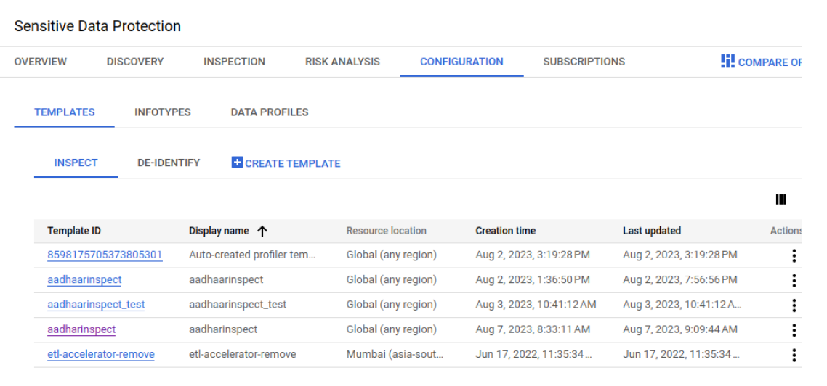
Data Loss Protection in Google Cloud
SAAS approach(Using Triggers and Jobs):-

Slide 7
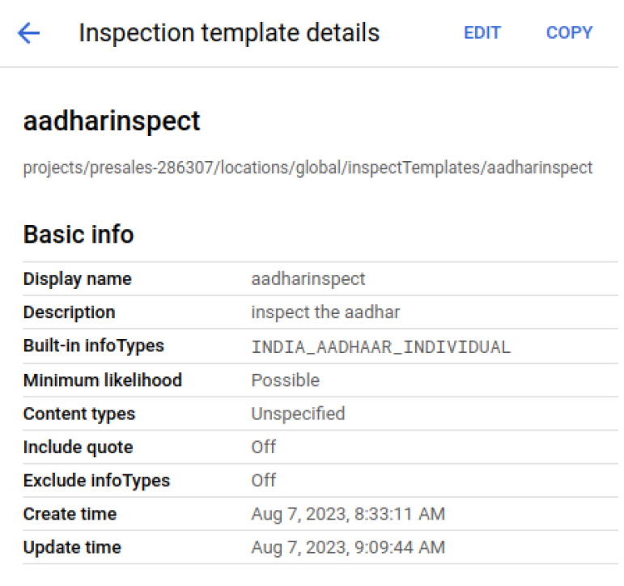
Data Loss Protection in Google Cloud
Inspection template

Slide 8
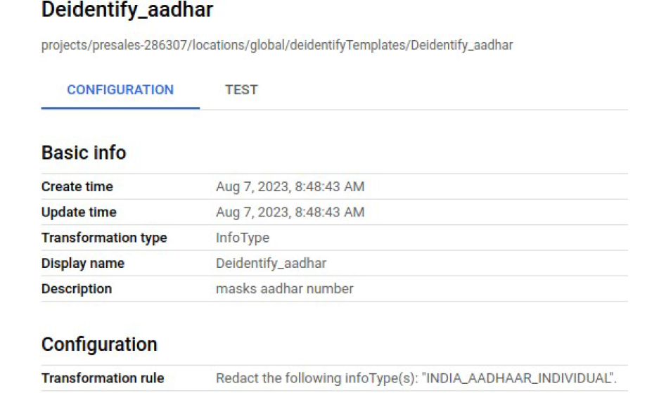
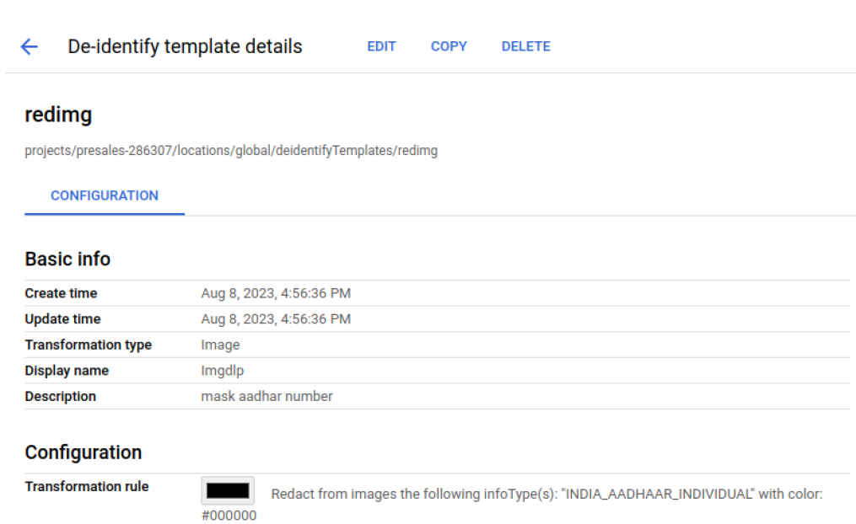
Data Loss Protection in Google Cloud
De-identification Template

Slide 9
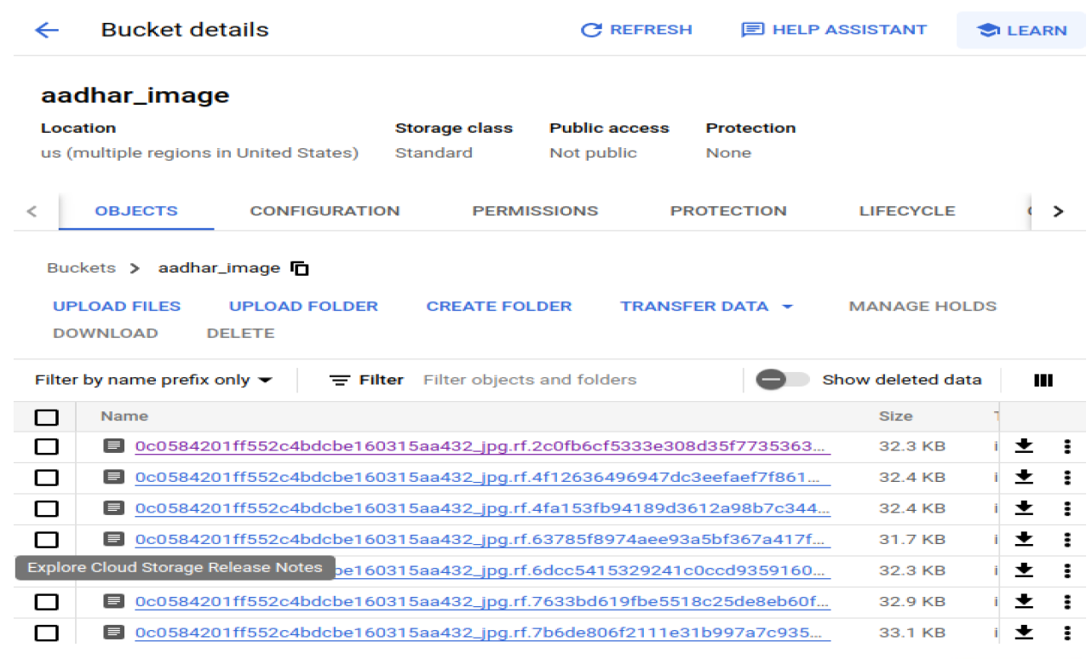
Data Loss Protection in Google Cloud
Input bucket

Slide 10
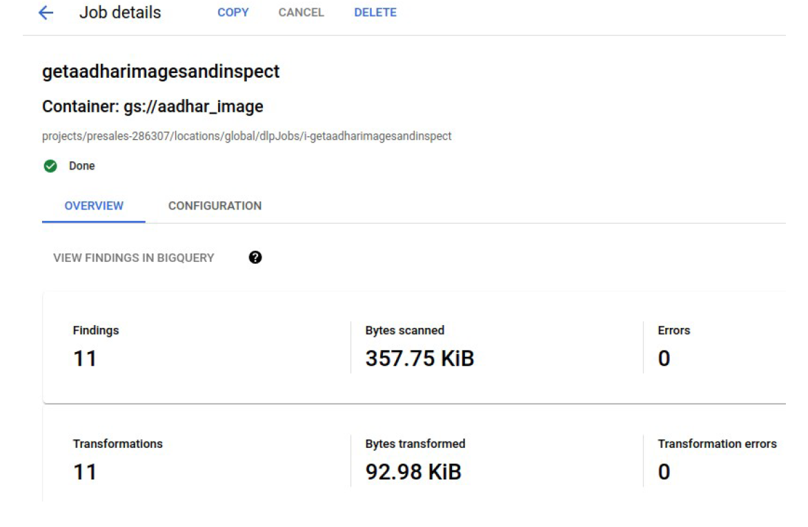
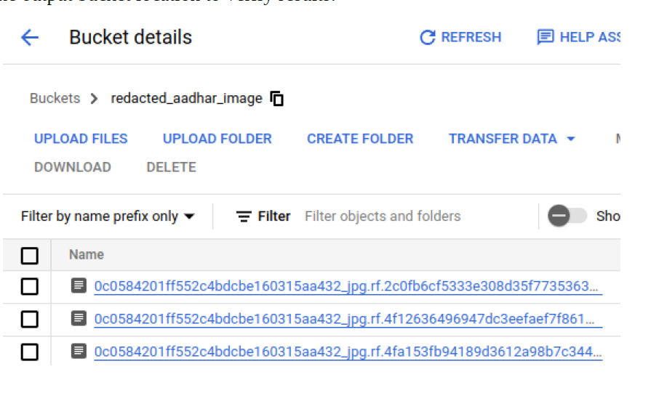
Data Loss Protection in Google Cloud
Running the jobs and triggers

Slide 11
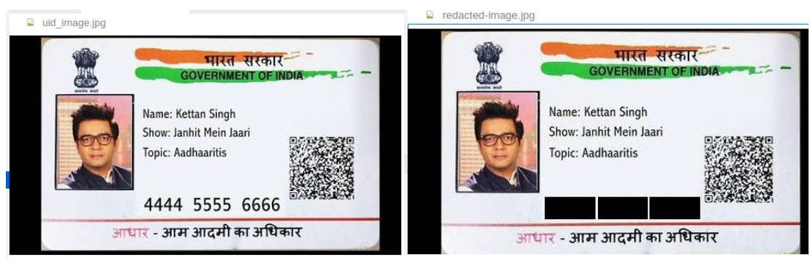
Data Loss Protection in Google Cloud
Final result

Slide 12
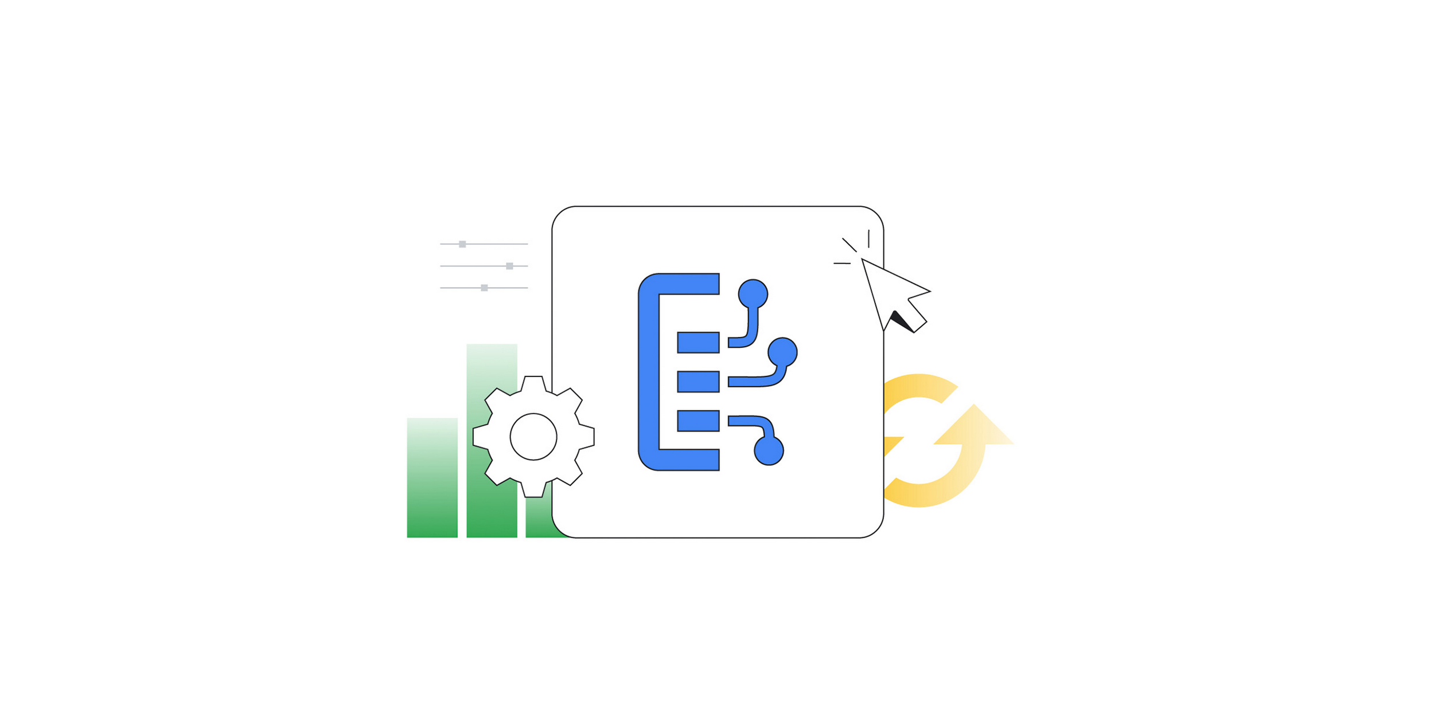
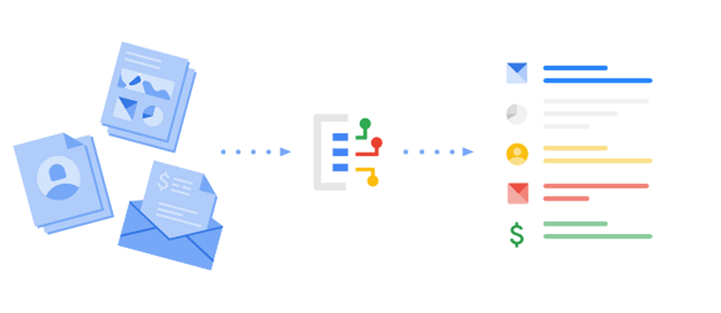
Document AI
Helps developers to create high-accuracy processors
- extract, classify, and split documents
Uses generative AI to extract and structure data in minutes
Use cases:-
Digitizing books for e-readers
Filling out medical intake forms at doctor's offices
Submitting expense reports based on receipts and invoices

Slide 13
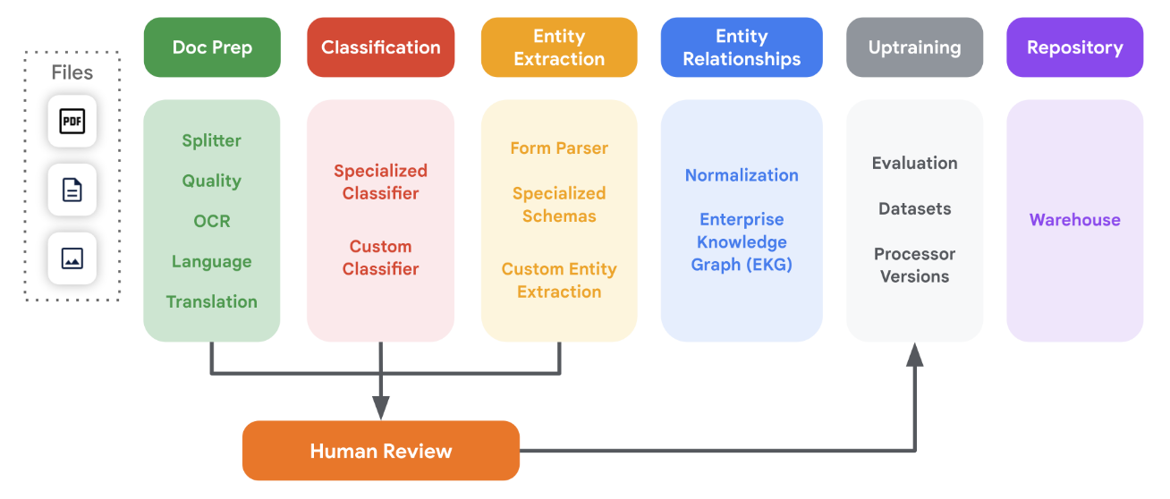
Document AI
Document processing steps:-

Slide 14
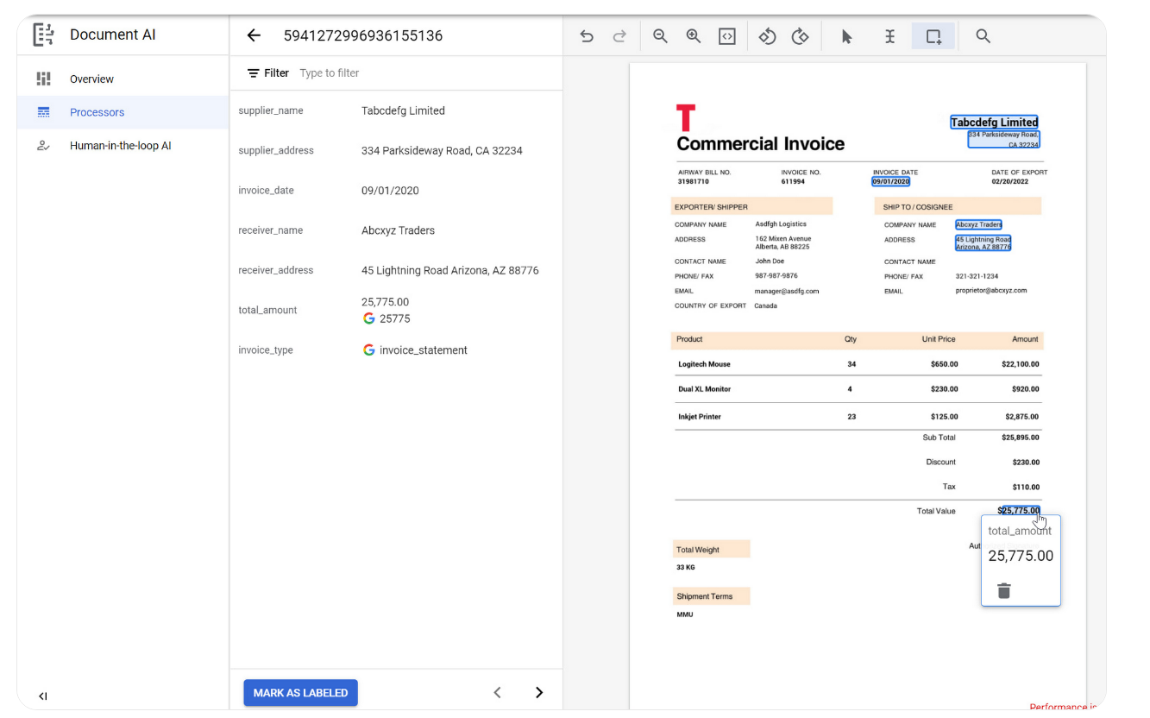
Document AI
Prepare training data

Slide 15
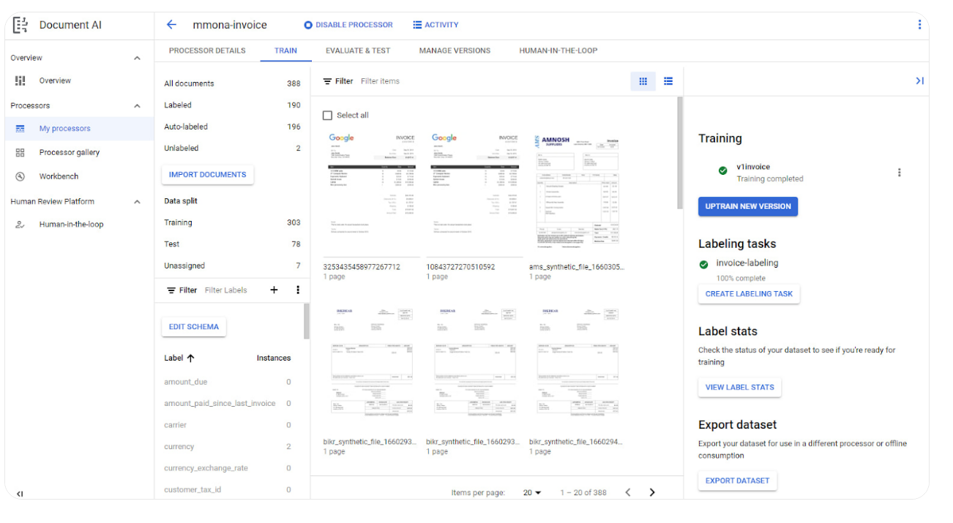
Document AI
Training the model

Slide 16
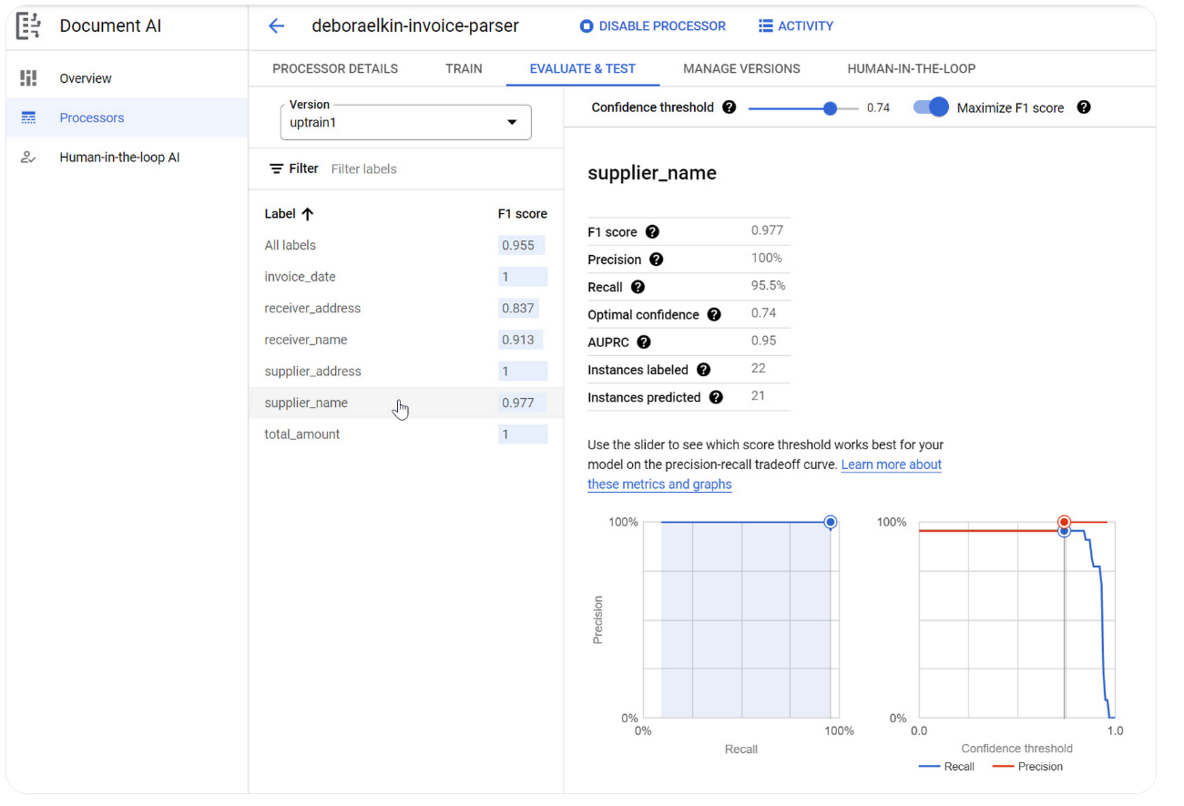
Document AI
Evaluating the model

Slide 17
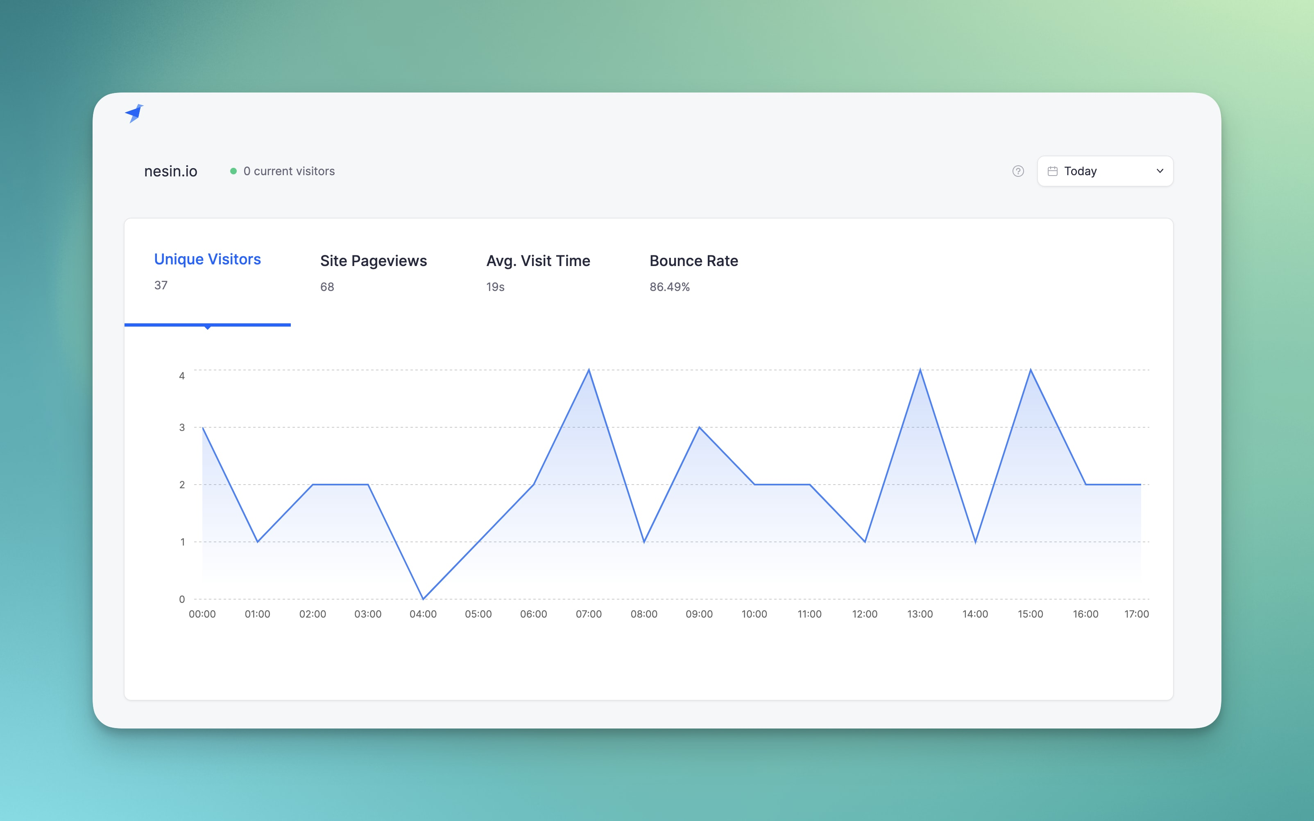
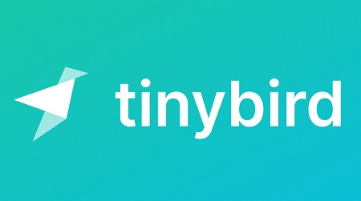
Integrating Kafka streams and Big Query data in Tinybird
Tinybird unifies your batch and streaming data
It is a real-time data analytics platform
Ingests data at scale, supports SQL and Git, and publishes API endpoints

Slide 18
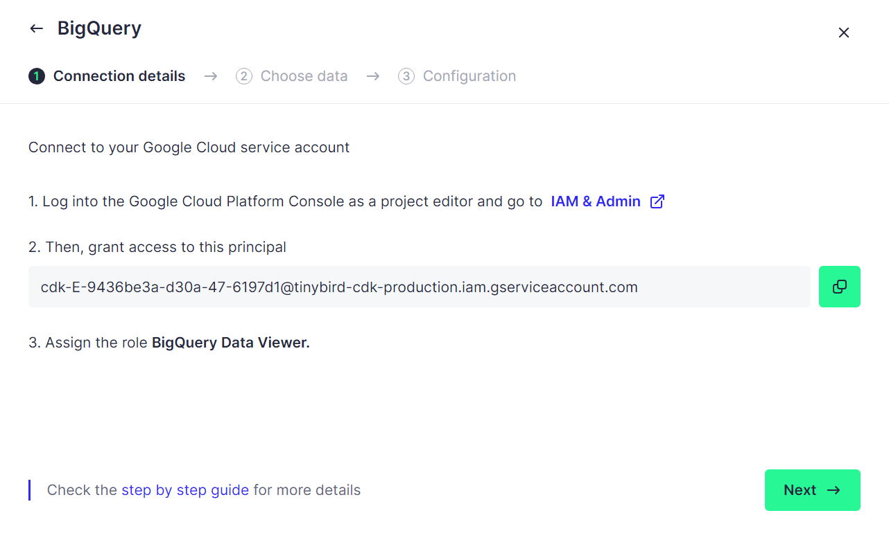
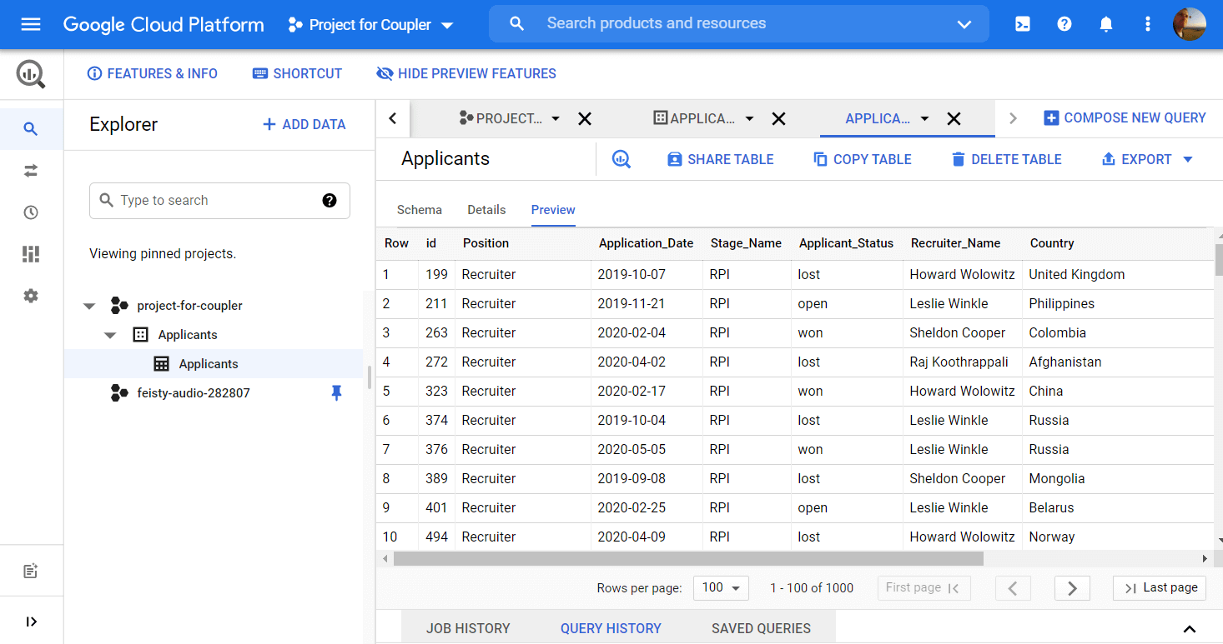
Integrating Kafka streams and Big Query data in Tinybird

Slide 19
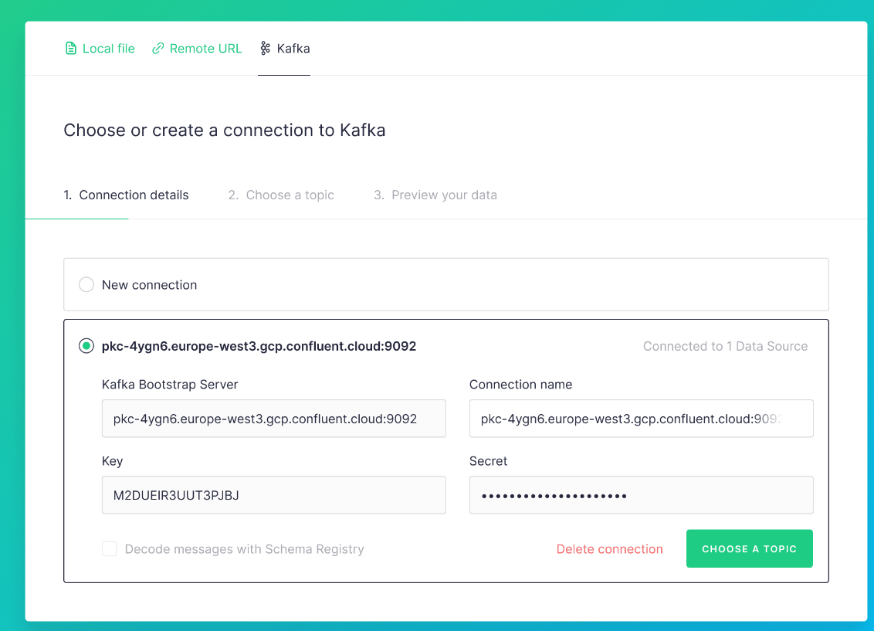
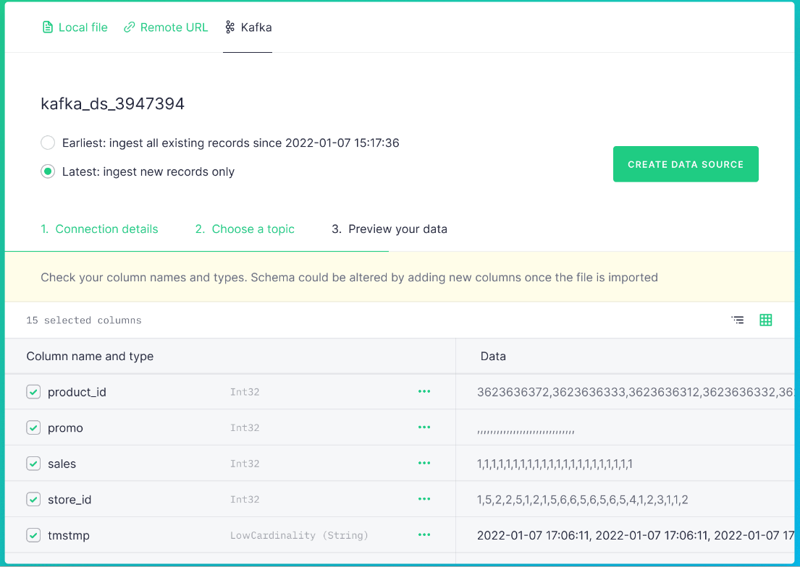
Integrating Kafka streams and Big Query data in Tinybird

Slide 20
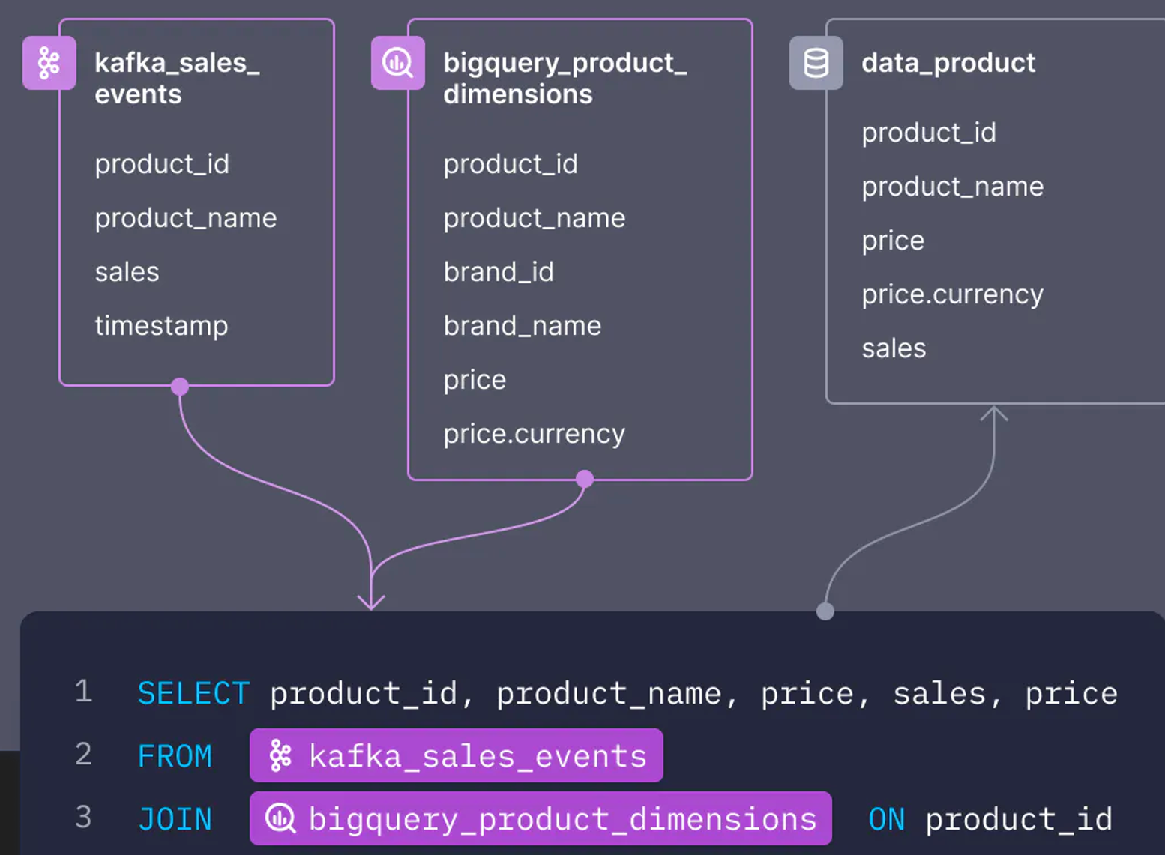
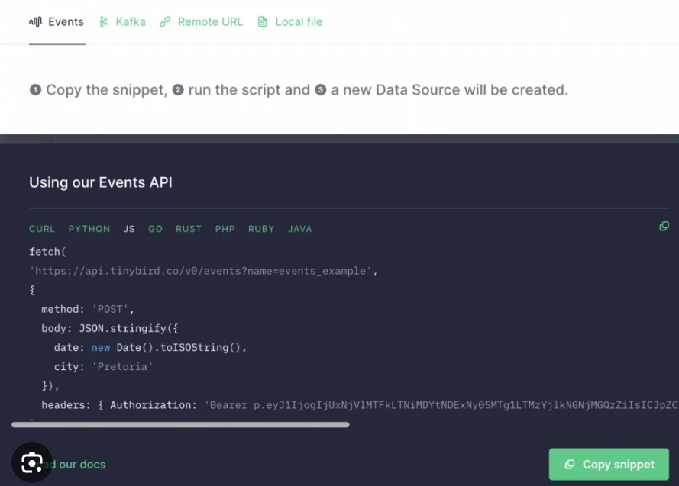
Integrating Kafka streams and Big Query data in Tinybird

Slide 21
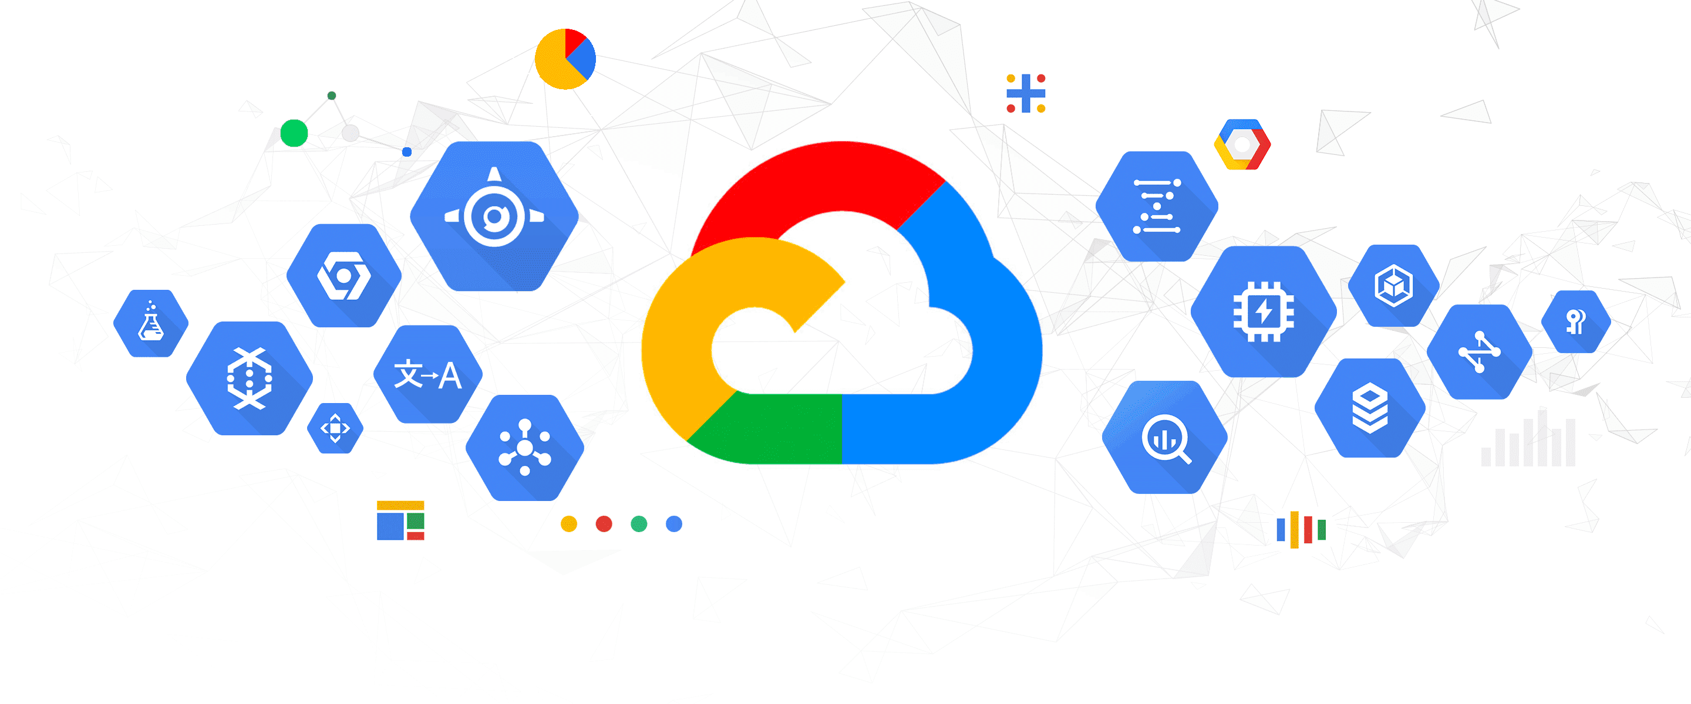
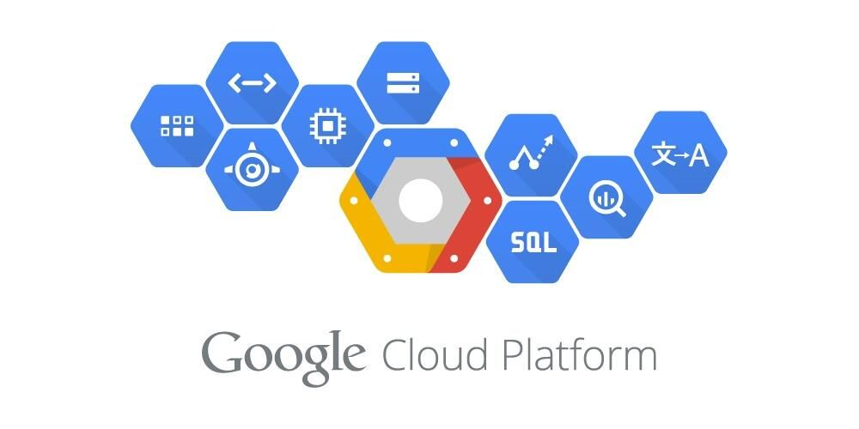
Conclusion
Learning Outcomes:-
Understanding of Google Cloud Services and Architecture
Networking
Soft Skills
Team Work

Slide 22
References
[1] https://cloud.google.com/dlp/docs
[2] https://cloud.google.com/document-ai/docs
[3] https://www.tinybird.co/docs
[4] https://www.confluent.io/product/confluent-platform/

Slide 23
Questions please ?

